Slide 1
MS Word
Creating A Flyer

Slide 2
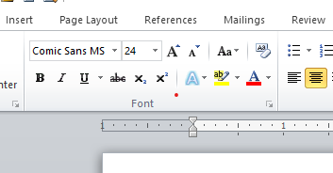
What do you Need to Know? Font
To format text in a Word document.
Here we can change anything about our text font.
Style
Size
Colour

Slide 3
What do you Need to Know? Font
Use the dropdown menus to select font type and font size
Use the surrounding buttons to select things like bold, italics, underline, strikethrough, colours etc

Slide 4
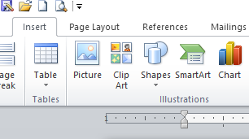
What do you Need to Know Insert a Picture
To insert a picture into a Word document, select the Insert menu from the ribbon
Click the picture button to select an image from your picture gallery or clipart to select an image from MS Word

Slide 5
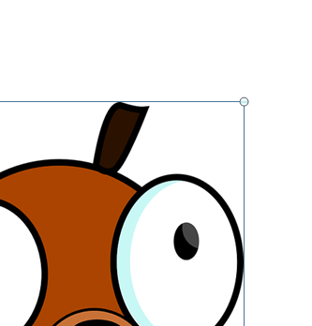
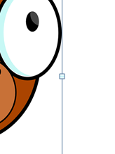
What do you Need to Know Resizing a Picture
To resize a picture use the handles around your image.
Handles on the corners will resize keeping the proportions of your image.
Handles on the sides will not keep image proportion.

Slide 6
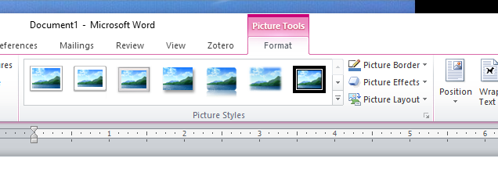
What do you Need to Know Formatting a Picture
Use the PICTURE TOOLS FORMAT menu
Use the dropdown menus to change elements of your picture

Slide 7
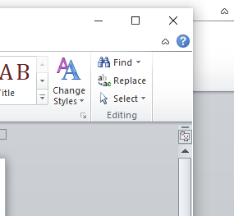
What do you Need to Know Style Sets
Style sets include a combination of title, heading, and paragraph styles.
From the HOME menu select the Change Styles dropdown menu and the Style Set option.
Select the Style Set you want

Slide 8
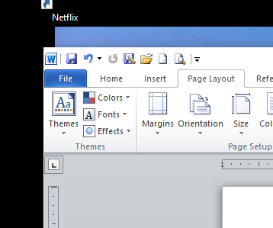
What do you Need to Know Themes
To change the theme of your document, go to the PAGE LAYOUT menu.
There are 4 dropdown menus to choose from
Select the appropriate menu to change each element (colour, font or effect)
Select an overall theme by using the THEME dropdown menu

Slide 9
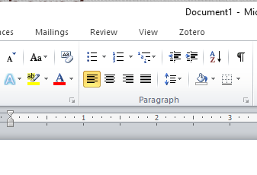
What do you Need to Know Bullets and Numbering
To add either bullets or numbering from the HOME menu, find the Paragraph group.
Use the bullets or numbering buttons
Pressing <enter> after a line formatted this way will automatically add the next number or bullet

Slide 10
What do you Need to Know Heading Styles
To change your Heading Styles use the Styles group on your HOME menu.
With the desired text selected, click the appropriate heading style

Slide 11
Assignment #3
Create a flyer
Use the flyer picture file on the webpage instead of the one indicated
Hand in on the U: drive or email if remote
Instead of using “Relaxed Perspective, White picture style”. Choose your own… but don’t leave it as the default.
Make sure your file is named <lastname><firstname> flyer.docx
DUE:

