Slide 1
History of Computer Science
Human Computers

Slide 2
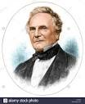
The Analytical Machine
Charles Babbage & Ada Lovelace
In 1837, Charles Babbage proposed the first general mechanical computer, the Analytical Engine.
The Analytical Engine contained an Arithmetic Logic Unit (ALU) basic, logic flow control flow, punch cards and integrated memory.

Slide 3
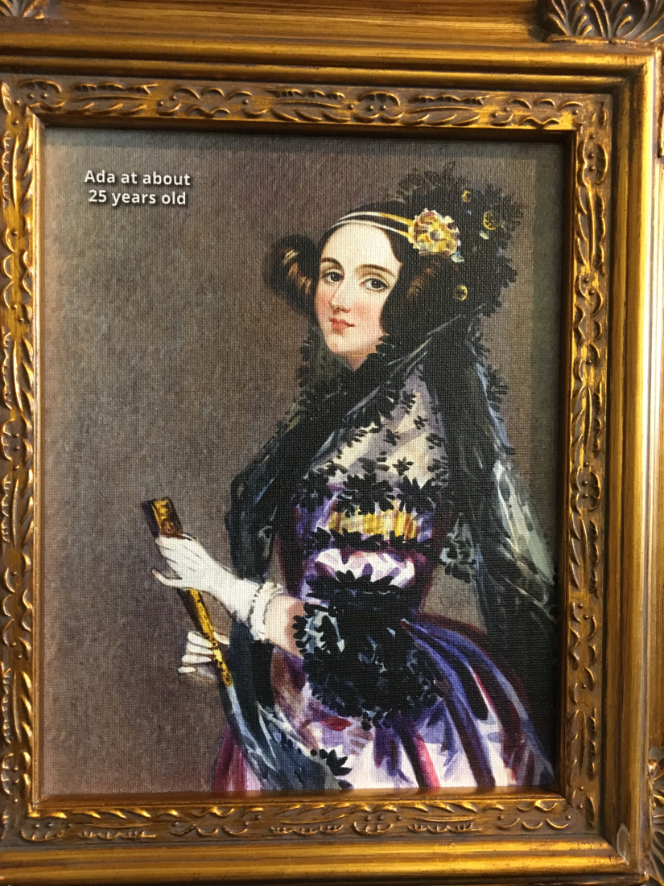
Charles Babbage (1791- 1871) & Ada Lovelace (1815 – 1852)
Logic for the Analytical Machine was programmed by mathematician Ada Lovelace, daughter of poet Lord Byron and is known for being the World’s First Computer Programmer.
The punch cards and readers were inspired by the Jacquard Loom used in the textile industry.

Slide 4
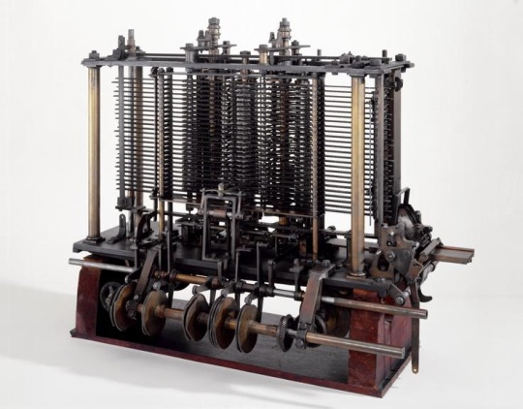
Charles Babbage & Ada Lovelace
It is the first general-purpose computer concept.
Unfortunately, because of funding issues, this computer was also never built while Charles Babbage was alive.
In 1910, Henry Babbage, Charles Babbage's youngest son, was able to complete a portion of this machine and was able to perform basic calculations.

Slide 5
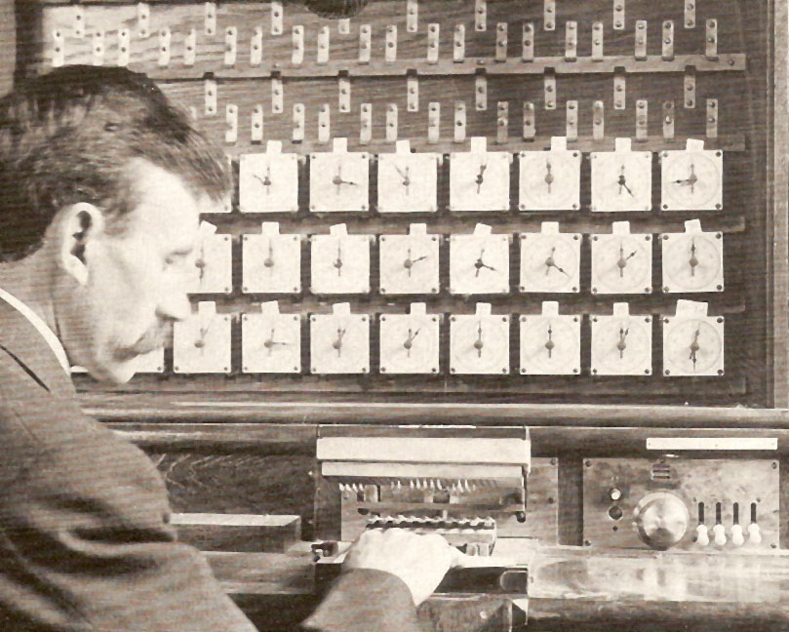
IBM
1890: Herman Hollerith designs a punch card system to calculate the 1880 census, accomplishing the task in just three years and saving the government $5 million. He establishes a company that would ultimately become IBM.

Slide 6
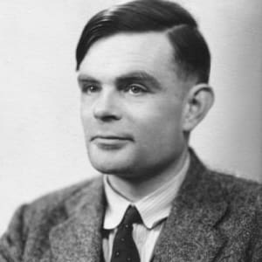
Alan Turing
1936: Alan Turing presents the notion of a universal machine, later called the Turing machine, capable of computing anything that is computable.
The central concept of the modern computer was based on his ideas.

Slide 7
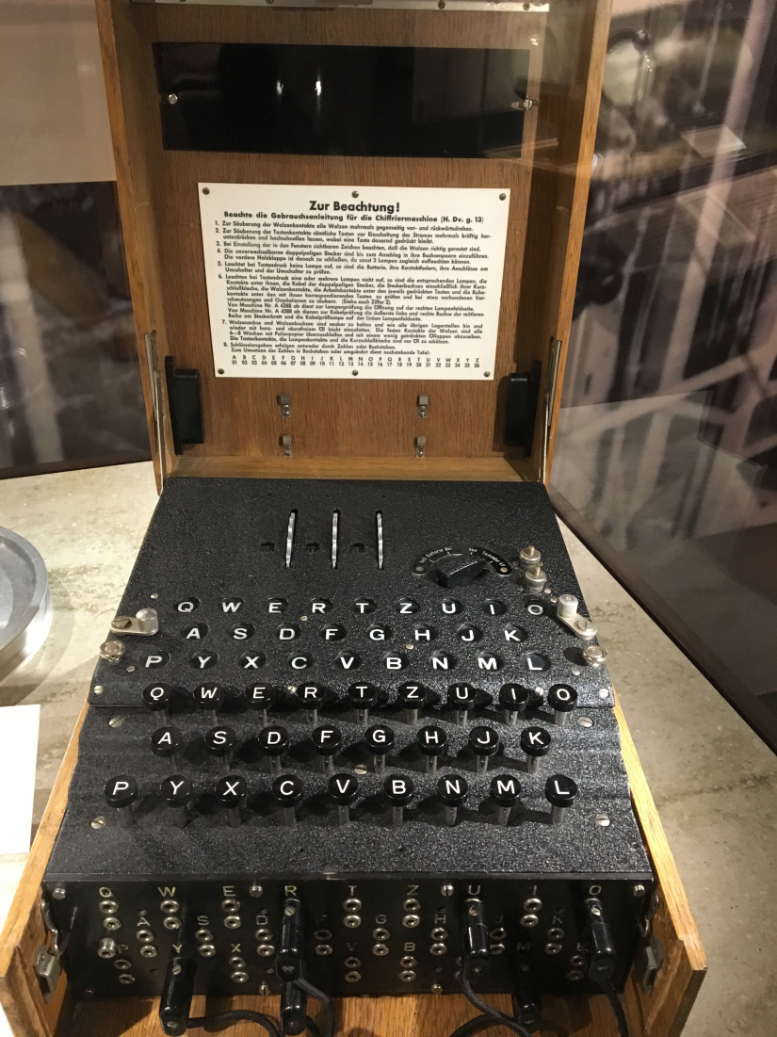
Alan Turing (1912-1954)
Alan Turing was most famous for heading the team that cracked the code of the German Enigma Machine 1943
Modern day Artificial Intelligence is found on ideas developed by Alan Turing

Slide 8
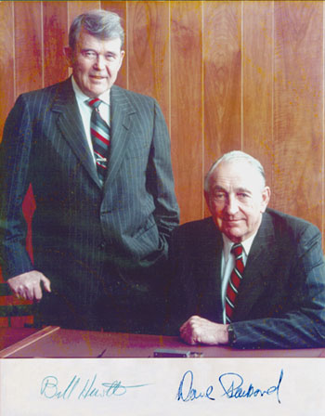
Hewlett-Packard
1939: Hewlett-Packard is founded by David Packard and Bill Hewlett in a Palo Alto, California (Now Silicon Valley)

Slide 9
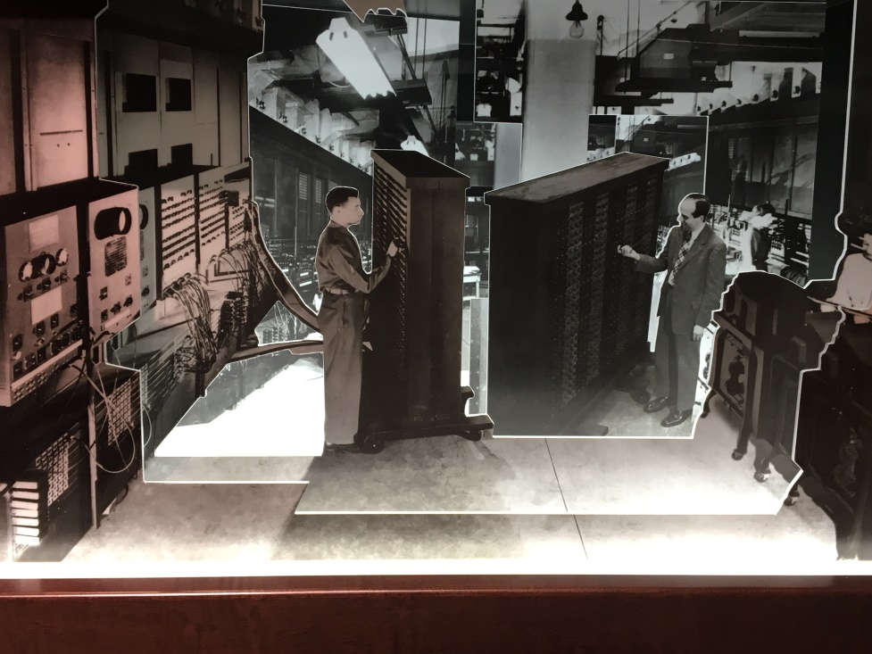
ENIAC
1943-1944: Two University of Pennsylvania professors, John Mauchly and J. Presper Eckert, build the Electronic Numerical Integrator and Calculator (ENIAC).
Considered the grandfather of digital computers, it fills a 20-foot by 40-foot room and has 18,000 vacuum tubes.
Notes:
Source: Computer History Museum

Slide 10
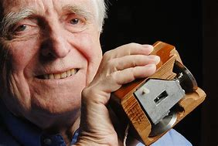
Douglas Engelbart
1964: Douglas Engelbart shows a prototype of the modern computer, with a mouse and a graphical user interface (GUI).
This marks the evolution of the computer from a specialized machine for scientists and mathematicians to technology that is more accessible to the general public.

Slide 11
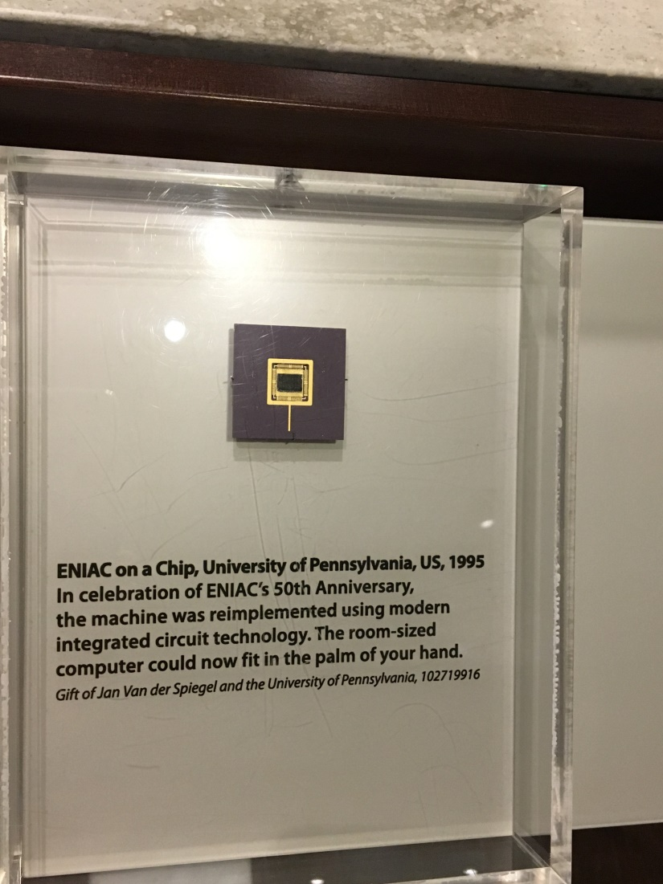
ENIAC
This ran at electronic speed without slowing down due to mechanical parts.
Until it was struck by lightening in 1955 it ran more calculations than all of humankind to that point
All of ENIAC can now fit on a single chip

Slide 12
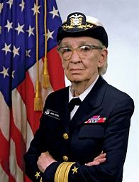
Grace Hopper (1906-1992)
Grace Hopper develops the first computer language, which eventually becomes known as COBOL.
Admiral in the US Navy
Discovered the first and coined the phrase “computer bug” when a moth was found in the computer.
Notes:
Source: Little Dreamers: Visionary Women Around the World (2018; Harrison, Vashti; ISBN:9870316475174)

Slide 13
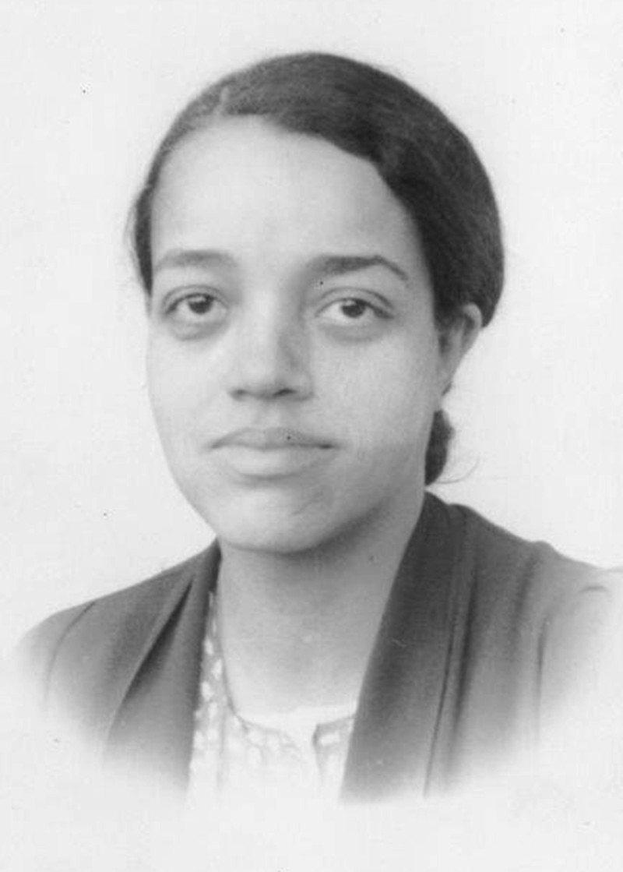
Dorothy Vaughn
1960s: Dorothy Vaughn prepared for the introduction to machine computers to NASA by learning and teaching her staff the machine language “FORTRAN” (Formula Translation)
Notes:
Resource: Hidden Figures

Slide 14
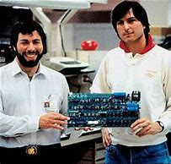
Steve Jobs & Steve Wozniak
1976: Steve Jobs and Steve Wozniak start Apple Computers on April Fool's Day and roll out the Apple I, the first computer with a single-circuit board, according to Stanford University.

Slide 15
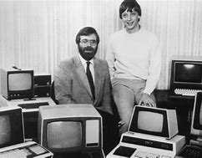
Bill Gates & Paul Allen
1975: The January issue of Popular Electronics magazine features the Altair 8080, described as the "world's first minicomputer kit to rival commercial models.
Paul Allen and Bill Gates, offer to write software for the Altair, using the new BASIC language. On April 4, after the success of this first endeavor, the two childhood friends form their own software company, Microsoft

Slide 16
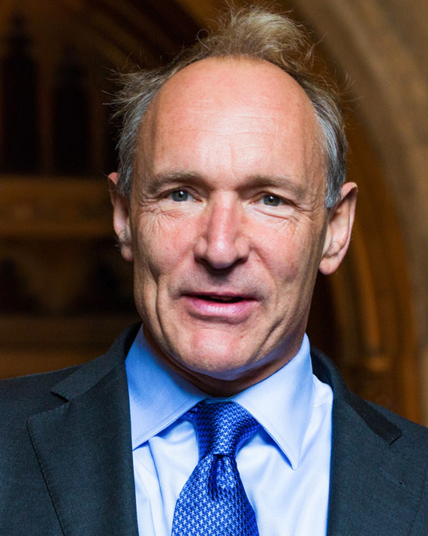
Tim Berners-Lee
1990: Tim Berners-Lee, a researcher at CERN, the high-energy physics laboratory in Geneva, develops HyperText Markup Language (HTML), giving rise to the World Wide Web.
Originally developed as a way for academics to share research

Slide 17
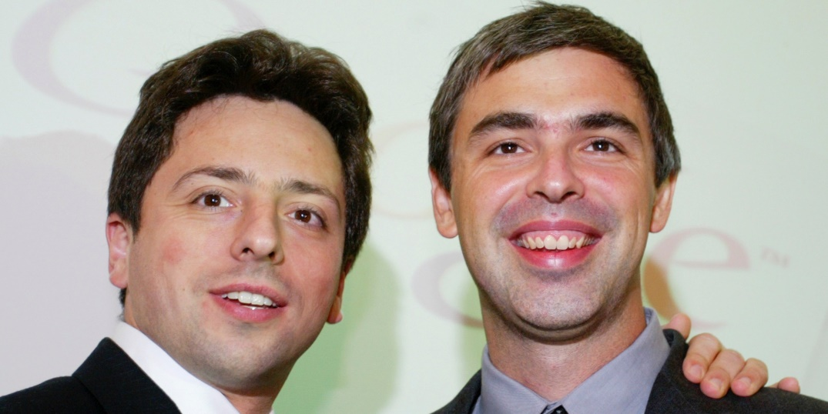
Sergey Brin & Larry Page
1996: Sergey Brin and Larry Page develop the Google search engine at Stanford University
Link: Algorithm Page Rank

Slide 18
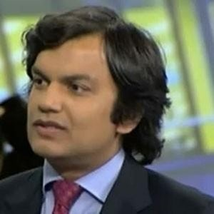
Ajay Kapur
Born in 1980 he is a computer scientist and musician specializing in musical robots and electronic instruments

