Slide 1
Flowchart and Sequencing

Slide 2
Today’s class
Algorithms
Flowcharts
Sequencing activity

Slide 3
What is an algorithm?
An algorithm is a set of instructions used to solve a problem.
Think of it like a recipe or driving directions
Steps to follow
Sequence of steps
Break a problem down into manageable steps
https://www.youtube.com/watch?v=6hfOvs8pY1k

Slide 4
A big problem
How do you build a house?

Slide 5
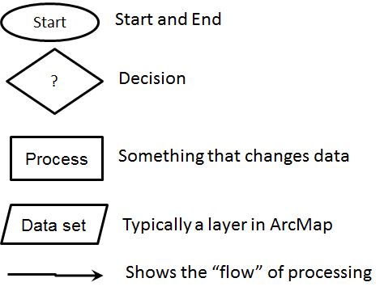
Flowchart
A flowchart is the graphical representation of the algorithm
Each type of instruction has a symbol
Input / Output

Slide 6
Flowchart Practice
Q1. Add 10 and 20
To solve this problem we will take a variable sum and set it to zero. Then we will take the two numbers 10 and 20 as input. Next we will add both the numbers and save the result in the variable sum i.e., sum = 10 + 20. Finally, we will print the value stored in the variable sum.
Notes:
https://dyclassroom.com/flowchart/exercise-1

Slide 7
Write it out in “pseudo code”
Initialize sum = 0 (PROCESS)
Enter the numbers (I/O)
Add them and store the result in sum (PROCESS)
Print sum (I/O)

Slide 8
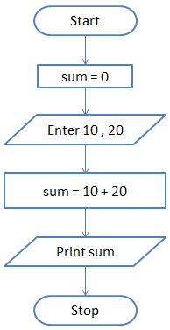
Draw the flowchart

Slide 9
Q2. Find the sum of 5 numbers
In this question we are asked to find the sum of 5 numbers. So, we will take two variables - sum and count and set both of them to zero. The sum variable will store the result while the count variable will keep track of how many numbers we have read.

Slide 10
To solve this problem we will use the concept of loop. In loop or iterative operation, we execute some steps repeatedly as long as the given condition is TRUE. In this case we will keep reading the input till we have read 5 numbers.

Slide 11
So, we first initialize sum and count to zero. Then we will take the input and store it in a variable n. Next we will add the value stored in n to sum and save the answer in sum.
i.e., sum = sum + n

Slide 12
Then we will increment count by 1 and check if count is less than 5. If this condition is TRUE then we will take another input. If the condition is FALSE then we will print the value stored in variable sum.

Slide 13
pseudocode
Initialize sum = 0 and count = 0 (PROCESS)
Enter n (I/O)
Find sum + n and assign it to sum and then increment count by 1 (PROCESS)
Is count < 5 (DECISION)
if YES go to step 2 else Print sum (I/O)

Slide 14
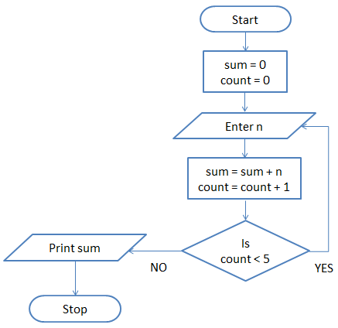

Slide 15
Your turn
Q3. Print Hello World 10 times
This problem is also solved using the loop concept. We take a variable count and set it to zero. Then we print "Hello World" and increment count by 1.
i.e., count = count + 1

Slide 16
Next we check if count is less than 10. If this is TRUE then we again print "Hello World" and increment the variable count. On the other hand if the condition if FALSE then we will stop.

Slide 17
Write the pseudocode
Initialize count = 0 (PROCESS)
Print Hello World (I/O)
Increment count by 1 (PROCESS)
Is count < 10 (DECISION)
if YES go to step 2 else Stop

Slide 18
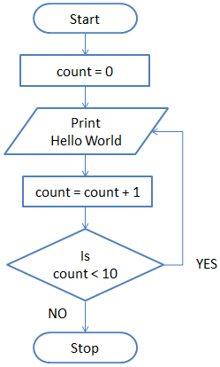
Draw the flowchart

Slide 19
Sequencing
Computers will do what you tell them to do in the order you tell it to do it.
https://codecombat.com/play

