Slide 1
Data Type Conversion

Slide 2
Automatic Type Conversion
Processing is a strongly typed language
Before you use a variable, you must declare it and provide the type of data it can contain
Once declared, the variable can only store that type of data
Moving data from one variable type to another can be an issue. If there is even a possibility that any error would be lost, Processing will return an error

Slide 3
Implicit Casting
Create a new sketch with the following code:
Try to run this code.

Slide 4
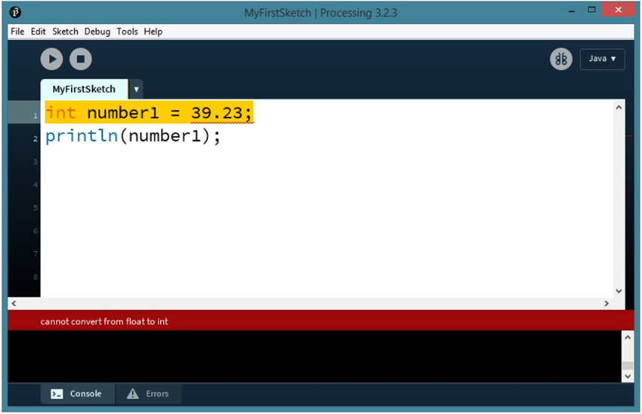
Implicit Casting

Slide 5
Implicit Casting
You are getting this error because you tried to put a decimal number (double) into a variable with an integer data type (int).
Since data could be lost (the numbers after the decimal would be lost) in this conversion, Processing displays an error.

Slide 6
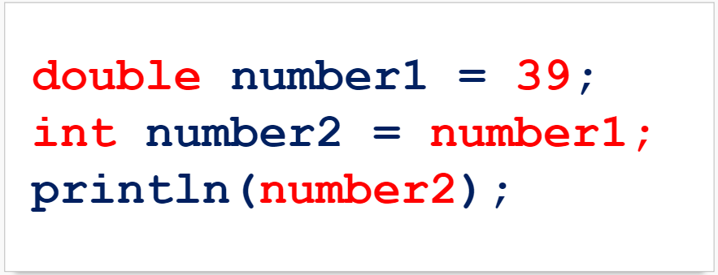
Implicit Casting
Let’s try this instead:
Try to run this code

Slide 7
Implicit Casting

Slide 8
Implicit Casting

Slide 9
Implicit Casting
Let’s try one more thing:
Try to run this code

Slide 10
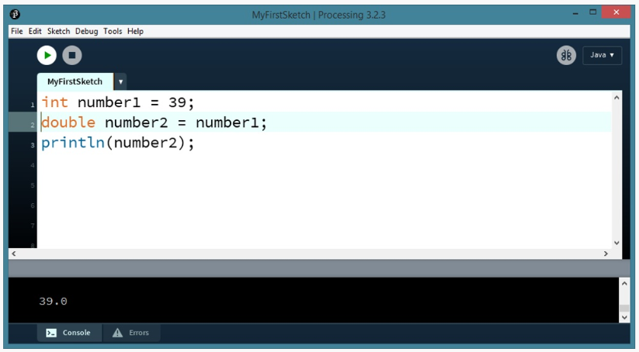
Implicit Casting
The code runs! The int variable number1 can go into the double variable number2.

Slide 11
Implicit Casting

Slide 12
Implicit Casting
Moving one data type to another is called Casting
If Processing allows one type to be moved to another because it knows there are no problems, this is called Implicit Casting
As long as the receiving data type is capable of holding the maximum or minimum potential value, Processing allows the assignment as no information would be lost.

Slide 13
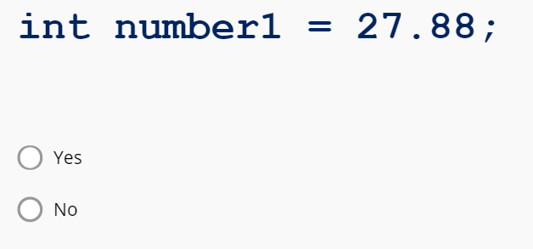
Implicit Casting Practice
Will this program run?

Slide 14
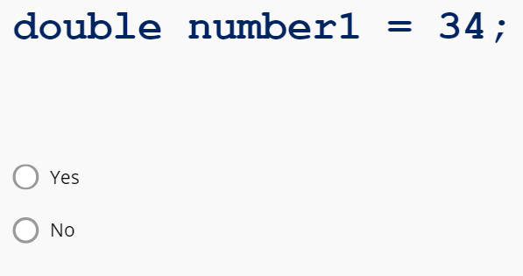
Implicit Casting Practice
Will this program run?

Slide 15
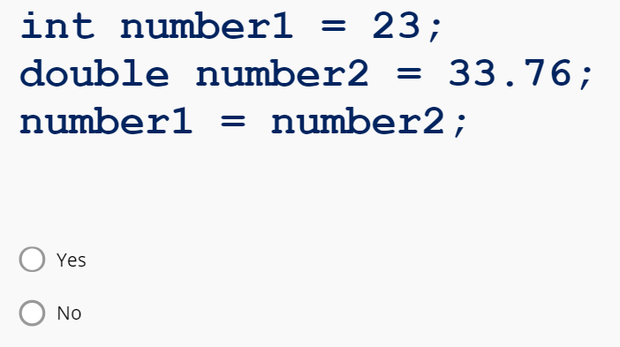
Implicit Casting Practice
Will this program run?

Slide 16
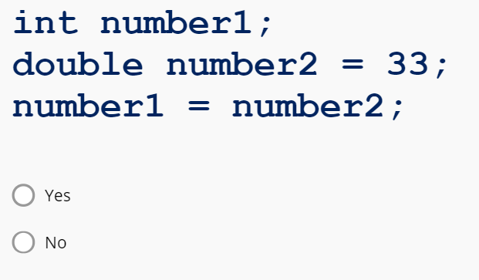
Implicit Casting Practice
Will this program run?

Slide 17
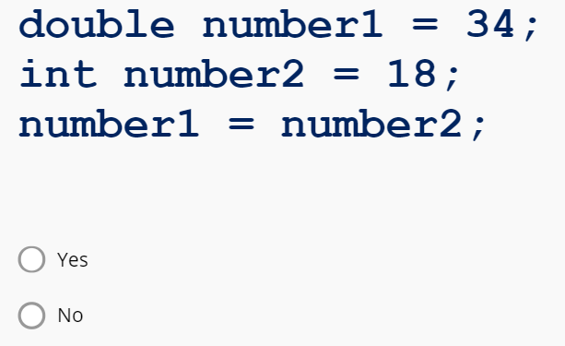
Implicit Casting Practice
Will this program run?

Slide 18
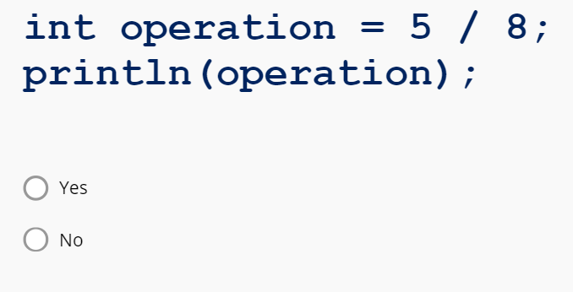
Implicit Casting Practice
Will this program run?

Slide 19
Explicit Casting
If you want to move one data type to another that Processing does not normally allow, you must perform an Explicit Cast
Explicit Casting can be done when you want to move one data type into another.

Slide 20
Explicit Casting
An explicit cast forces Processing to move one data type into another, even if this is not normally allowed:

Slide 21
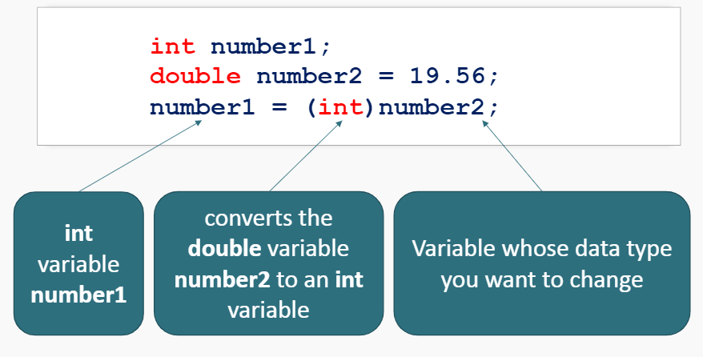
Explicit Casting
For example:

Slide 22
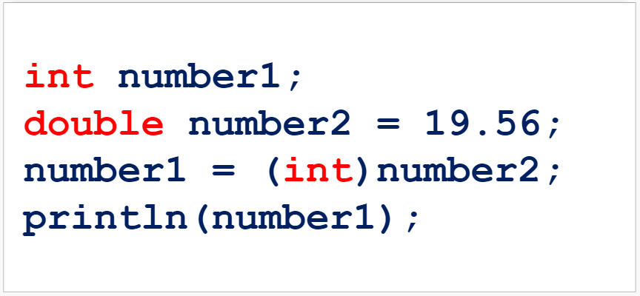
Explicit Casting
What is the output of this code?

Slide 23
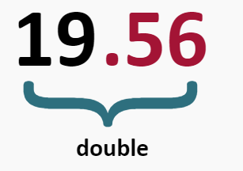
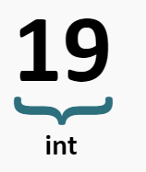
Explicit Casting
The class compiles and runs, however, the variable number1 that we printed went from 19.56 to 19 in the number conversion

Slide 24
Explicit Casting
Explicit Casting is not always allowed.
Sometimes the data types of two variables are so different that one cannot be converted to another.
An example is the Boolean data type. It cannot be cast to other data types at all, nor can other data types be cast into it.
When doing more advanced programming, explicit casting does not always work either.

Slide 25
Explicit Casting Practice
Fill in the blanks in the code snippet below so that the code will run with no errors.

Slide 26
Explicit Casting Practice
Fill in the blanks in the code snippet below so that the code:

Slide 27
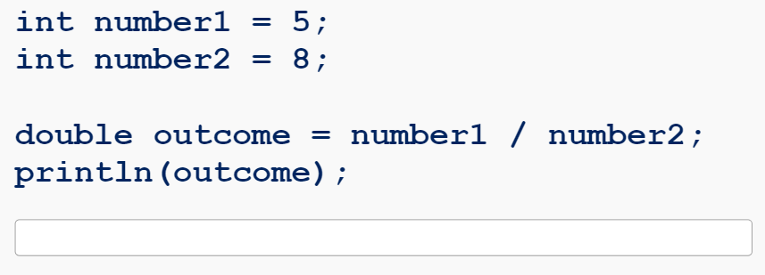
Explicit Casting Practice
Challenge: Try it yourself!
What is the output of the following code:

Slide 28
Explicit Casting Practice
Challenge: Try it yourself!
What is the output of the following code:

Slide 29
Summary
Casting is moving one data type to another
Implicit Casting is when Processing allows one data type to be moved to another
Explicit Casting is when you force one data type into another data type which would not normally be allowed
Explicit Casting is done when using the following syntax:

