Slide 1
Program Errors

Slide 2
Program Errors
All programmers will encounter three different types of errors:
Syntax
Run Time
Logic

Slide 3
Program Errors
Syntax
Violate syntax rules
Causes compiler to produce error messages
Generally the easiest to fix
Run Time
Program compiles and runs, but “crashes”
These can be simple or complex, depending on the situation
Logic
Program compiles & runs normally, but produces incorrect results
These are usually the most difficult to find and correct

Slide 4
Syntax Errors
Syntax Errors occur when your code is not written using the language rules.
This code has a Syntax Error, can you find it?

Slide 5
Syntax Errors
Syntax Errors occur when your code is not written using the language rules.
This code has a Syntax Error, can you find it?

Slide 6
Runtime Errors
Runtime errors occur when you try to run your program, but your code is attempting to do something that Processing cannot do.
This type of error results in the program terminating unexpectedly
Since the program stops suddenly, it is often called a crash, or a program crash.

Slide 7
Runtime Errors
The following code experiences a runtime error, why?

Slide 8
Runtime Errors
In this program, you are trying to divide by 0, this is impossible and so the program crashes

Slide 9
Logic Errors
Logic errors are by far the most difficult to deal with
Programs experiencing these errors will run and complete successfully
There are no problems with syntax, and you have not tried to do something that Processing is incapable of.
In order to locate the problem, you need to debug the program, or find the cause of the problem buried in the code.

Slide 10
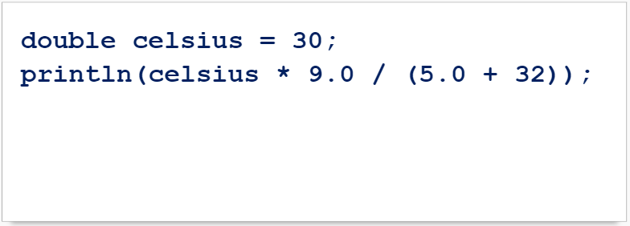
Logic Errors
This program that converts Celsius to Fahrenheit has a logic error, can you find it?

Slide 11
Logic Errors
This program that converts Celsius to Fahrenheit has a logic error, can you find it?
Removed inner brackets

Slide 12
Debugging
The process of debugging is needed when your program experiences either runtime or logic errors.
There are several methods you can use to debug your programs.
Desk checking
Outputting value to the console
Use a debugging utility

Slide 13
Debugging
Desk Checking the program is done by reading the code and trying to follow how it executes
Also called Hand Tracing, this process involves keeping track of the values of every variable (usually on paper).
The form of debugging is the slowest and is usually used for smaller programs.

Slide 14
Debugging
Output values to the Console uses println() statements to print out variable values and notations as the program executes.
This allows you to see the values of variables as the program is running, and you can illustrate the path of the logic.

Slide 15
Debugging
A debugging utility is a program provided with most development environments
It allows a programmer to follow the execution of a program one statement at a time
The debugger also keeps track of values, and are usually displayed in an easy to read window.

Slide 16
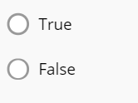
Debugging a Program Practice
A logic error will cause the program to crash.

Slide 17
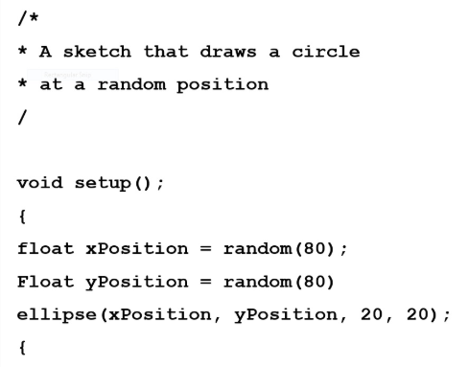
Debugging a Program Practice
Find the 5 errors in this program and describe how to correct the error:

Slide 18
Summary
Syntax Errors
Violate syntax rules
Causes compiler to produce error messages
Run Time Errors
Program compiles and runs, but “crashes”
These can be simple or complex, depending on the situation
Logic Errors
Program compiles & runs normally, but produces incorrect results
These are usually the most difficult to find and correct.

