Slide 1
Random

Slide 2
The random() function
The random() function generates a random number.
The random() function always returns a double (a number with numbers after the decimal point)
Random() returns a random number up to a given maximum or between a given range of numbers.

Slide 3
The random() function
For example:
Will print a random number between 0 and 50.
Try it yourself!

Slide 4
The random() function
For example:
Will print a random number between 20 and 50.
Try it yourself!

Slide 5
Try It Yourself
Create a new Processing sketch that draws a circle with a random width and height at the centre of the display window
Hint! You can use the built in variables width and height to create this sketch.

Slide 6
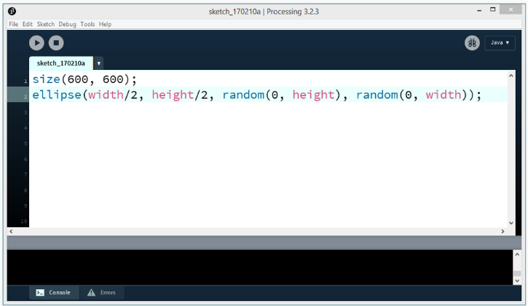
Try It Yourself Solution

Slide 7
Storing Random Numbers
Random numbers created using the random() function can also be stored into variables.
For example:

Slide 8
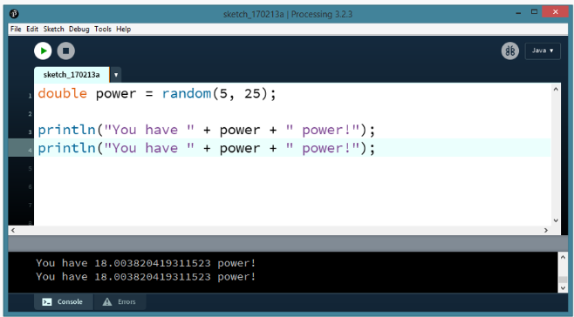
Storing Random Numbers
Now that the random number is stored in a variable, the number won’t change until you reset it or re-run the program.

Slide 9
Casting to an Integer
It is possible to convert (cast) a random number into an integer. This is a more advanced topic that you can research on your own.
To convert a random number to an integer, use the following syntax:

Slide 10
Summary
Random numbers are generated using the random() function.
Random() returns a random number up to a given maximum or between a given range of numbers.
These random numbers are always of the double data type.
You can store random numbers to a variable and that variable won’t change until you change it manually or re-run your program.

