Slide 1
Images in Processing

Slide 2
Images in Processing
Images can be created and used in Processing
The first step in using images in processing is to download the images you need to your computer.
Next drag the file into Processing. This will put the file in your code folder.

Slide 3
Pimage Data Type
Before you create an image, you have to create a variable of type Pimage to store it.
We can declare a smileyFace variable to eventually store an image:

Slide 4
Pimage Data Type
Type the code required to declare a Pimage variable called frown.

Slide 5
Pimage Data Type
Type the code required to declare a variable called laugh that will store an image.

Slide 6
loadImage()
Now we can load an image to store into our new smileyFace variable.
We use the function loadImage() to tell Processing to load our specific image. The loadImage() function accepts a filename as an argument.

Slide 7
loadImage()
Fill in the blanks in the code snippet below to load an image called “kitten.png” into a variable.

Slide 8
loadImage()
Fill in the blanks in the code snippet below to load an image called “home.jpg” into the home variable.

Slide 9
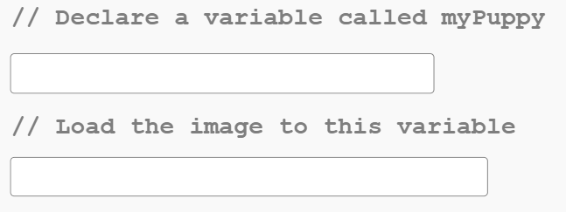
loadImage()
Fill in the blanks in the code snippet below to load an image called “puppy.jpg” into a variable called myPuppy.

Slide 10
Image()
Now we can draw our image to the screen using the image() function
The image() function works in a similar way to the drawing functions in that it draws an image to the screen at given coordinates.
The image() function requires 3 arguments:

Slide 11
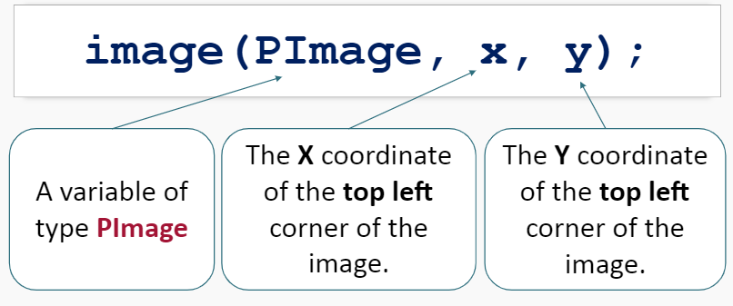
Image()

Slide 12
Image()
This code will draw our smileyFace image with the top left corner of the image at (10,10);

Slide 13
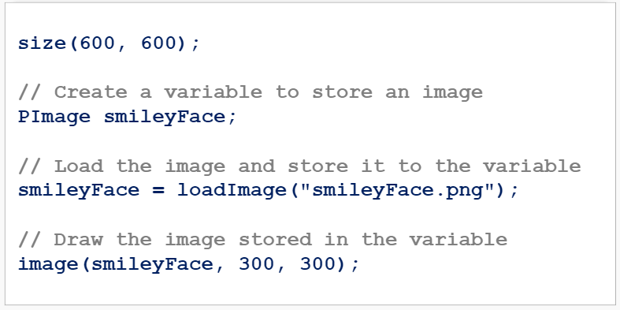
Image()
The following code will draw an image to the screen at location (300,300):

Slide 14
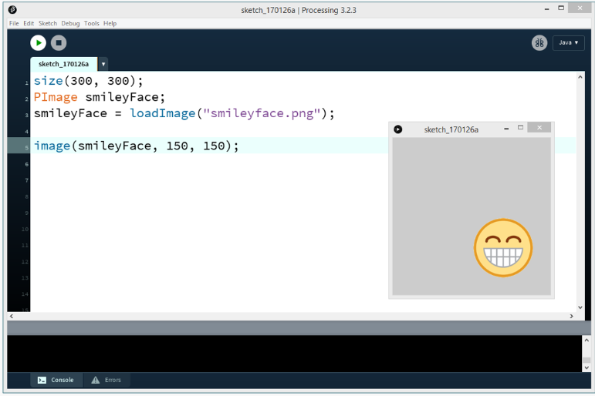
Drawing an Image

Slide 15
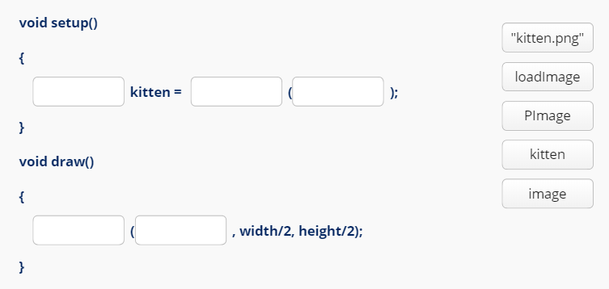
Image()
Complete the code below to draw the “kitten.png” image with the top left corner at the centre of the display window.

Slide 16
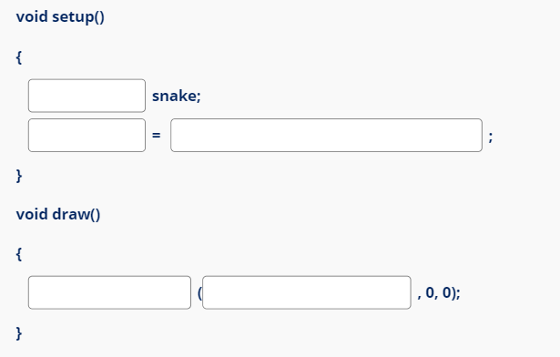
Image()
Fill in the blanks in the code snippet below to draw the image “snake.png” with the top left corner at point (0,0).

Slide 17
Summary
The steps to load an image are:
Declare a variable of type Pimage to store the image.
Use the loadImage(“filename.file”) function to assign an image to the Pimage variable.
Draw the image to the display window using the image(image, X, Y) function.

Slide 18
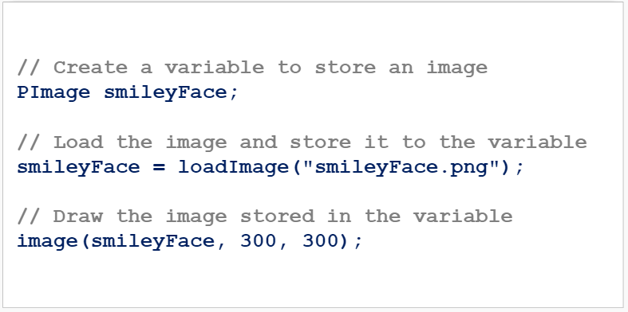
Summary

