Slide 1
Code Standards for Processing

Slide 2
Commenting Code
Commenting your code is required.
Your comments should be full English sentences explaining all ​​​statements and expressions found in your code.
You should have approximately one comment per statement.
Your comments should be detailed enough to demonstrate a solid understanding of your code.​
When commenting, do not place any blank lines between the comment and the line of code it is describing.

Slide 3
Commenting Code

Slide 4
Naming Conventions
All identifiers (names) must be descriptive and spelled out in full.
The name should describe the exact purpose of the thing being named.
For both Variable and Function identifiers the first word in the name is always lowercase, all subsequent words have the first letter in uppercase. (This is called camelCase.)
Additionally:
The first character must be a lowercase letter, not a number.
Remaining positions can be filled with numbers or letters.
Variable names cannot contain spaces.
Variables are case-sensitive. They must be written the same way every time.

Slide 5
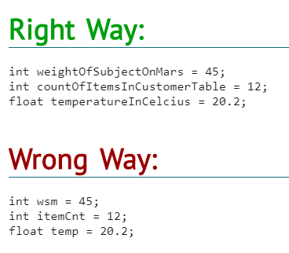
Naming Conventions

Slide 6
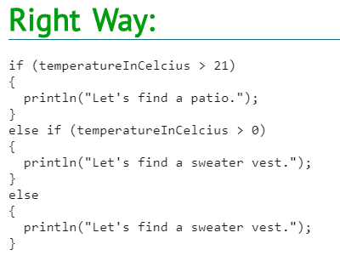
Block Styles
Blocks must always be delimited using curly braces '{' and '}' even if they only contain a single statement.

Slide 7
Block Styles

Slide 8
Indenting Code
Not all statements start on the left side of the editor window. Code is indented (moved to the right) so that blocks of code are visually grouped together. Indenting code improves code readability by making it easy to see which statements belong to what block.
The rules for indentation are:
All statements within a code block are indented two spaces to the right.
A code block within a code block adds a further level of two space indentation.
You do not need to use the space key to indent. In the Processing IDE the tab key will automatically insert two spaces.

Slide 9
Indenting Code

