Slide 1
Increment and Decrement Operators

Slide 2
Increment and Decrement Operations
Frequently variables must be incremented (added to) or decremented (subtracted from) using a value of one.
The traditional approach would be to use the following statements:

Slide 3
Increment and Decrement Operations
For example, the code:
Would output the value: 2

Slide 4
Increment Operations
Processing has shortcuts to use instead of those traditional statements
Instead of:
We can use:

Slide 5
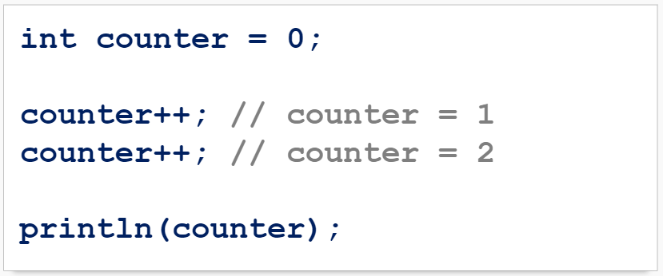
Increment Operations
For example, the code:
Would output the value: 2

Slide 6
Decrement Operations
Instead of:
We can use:

Slide 7
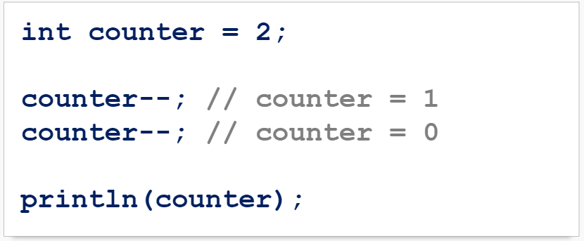
Increment and Decrement Operations
For example, the code:
Would output the value: 0

Slide 8
Increment and Decrement Practice
What is the output of the following code?

Slide 9
Increment and Decrement Practice
What is the output of the following code?

Slide 10
Increment and Decrement Practice
What is the output of the following code?

Slide 11
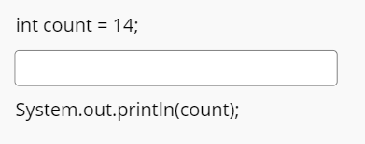
Increment and Decrement Practice
Fill in the blanks in the code snippet below using increment and decrement shortcut operators to get the output:

Slide 12
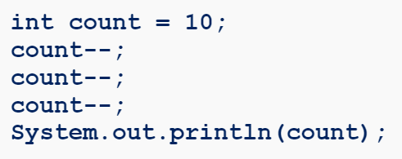
Increment and Decrement Practice
What is the output of the following code?

Slide 13
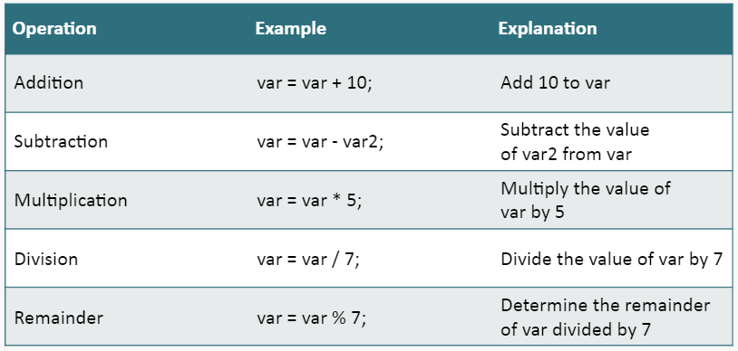
Shortcut Assignment Operators
Another operation often used by programmers is to modify the value of a variable using another value other than the one. Some examples:

Slide 14
Shortcut Assignment Operators
These types of operations can be done with a shortcut:

Slide 15
Shortcut Assignment Operators
To assign the result of multiplying the value of count by 6 to the variable count:
To assign the result of dividing the value of circle by the variable pi to the variable circle:
To assign the result of subtracting the value of total by 5 to the variable total:

Slide 16
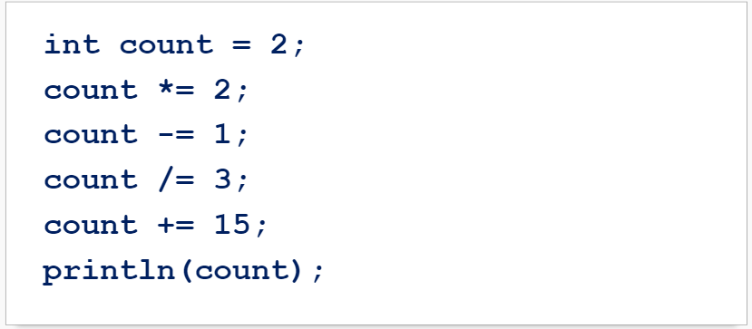
Shortcut Assignment Operators
What would the output of this code be?
Try it yourself!

Slide 17
Shortcut Assignment Operators

Slide 18
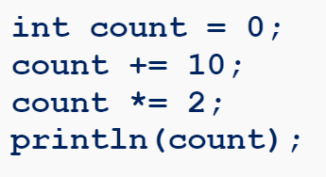
Shortcut Operators Practice
What is the output of the following code?

Slide 19
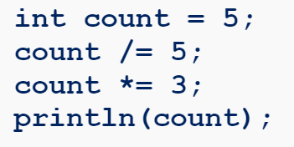
Shortcut Operators Practice
What is the output of the following code?

Slide 20
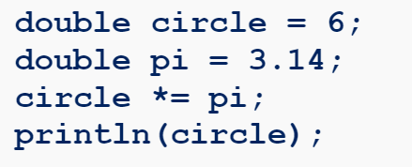
Shortcut Operators Practice
What is the output of the following code?

Slide 21
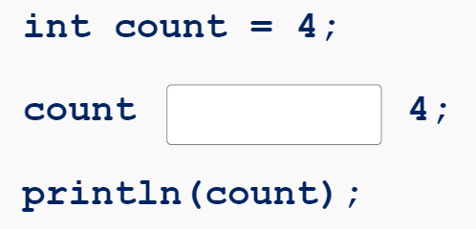
Shortcut Operators Practice
Fill in the blanks in the code snippet below so the code outputs:

Slide 22
Summary
Instead of:
We can use:
Instead of:
We can use:

Slide 23
Summary
Operators also have a shortcut:
Instead of:
We can use:

