Slide 1
Drawing Functions

Slide 2
Processing Functions
Processing contains many built-in Functions for drawing on the screen.
Functions are the actions or verbs of the code sentence.
Functions sometimes need details, called Arguments to perform their actions.
When we use functions we say we are “Calling” the function.

Slide 3
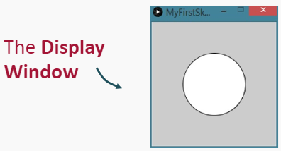
The Display Window
Before we can draw, we must create a canvas. In Processing, this canvas is called the Display Window.
The size() function sets the size of the display window we can draw on.
The Display Window is measured in pixels.
The default size is 100px by 100px.

Slide 4
Setting the Window Size
The size() built-in function defines the size of the display window in pixels.
The size() function takes two Arguments:

Slide 5
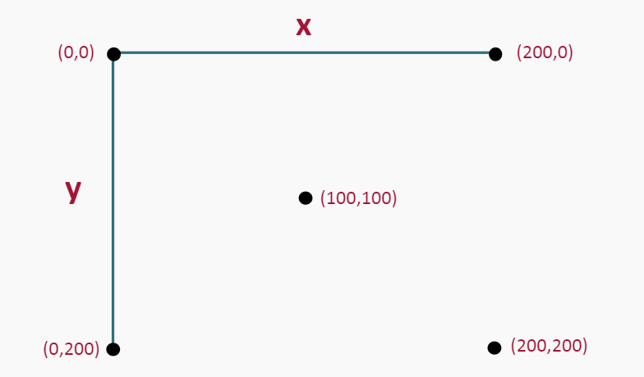
The Display Window
The display window is like a grid. For example, a window that is 200px by 200px would look like this:

Slide 6
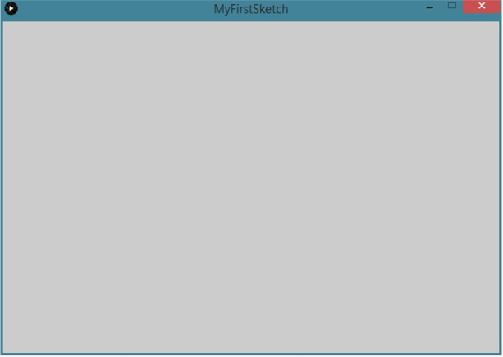
Try It Yourself
Create a blank window that is 600px by 400px.

Slide 7
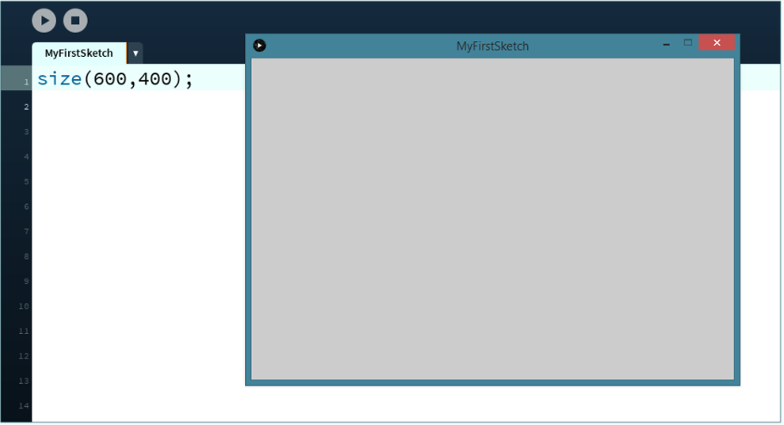
Try It Yourself Solution

Slide 8
Drawing a Line
We can use the built in line() function to draw a line.
The line() function needs four arguments:

Slide 9
Drawing a Line
For example, the code:
Will draw a line from point (100,100) to point(200,200).
Try it yourself in Processing

Slide 10
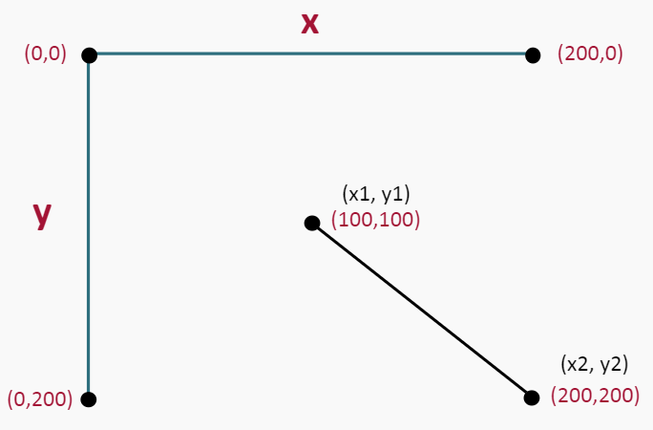
Drawing a Line
In a window that is 200px by 200px, the line looks like this:

Slide 11
Drawing Lines Practice
Fill in the blanks in the code snippet below to draw a line from point (100, 200) to point (300, 300).

Slide 12
Drawing Lines Practice
Fill in the blanks in the code snippet below to draw a line from point (200, 200) to point (400, 300).

Slide 13
Try It Yourself
Draw a line from point (100,0) to point(100,100) in a window that is 200px by 200px.
Set the window size to 200px by 200px
Draw a line from point (100,0) to point (100,100).

Slide 14
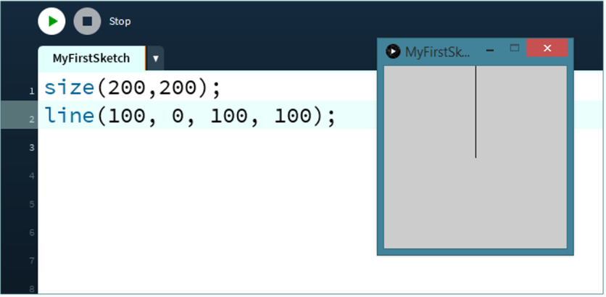
Try It Yourself Solution

Slide 15
Drawing an Ellipse
The ellipse() function draws ovals and circles.
This function takes 4 arguments:

Slide 16
Drawing an Ellipse
For example, the code:
Will draw an ellipse with the centre at the point (100, 100) that is 100px wide and 100px high.
Try it yourself in Processing

Slide 17
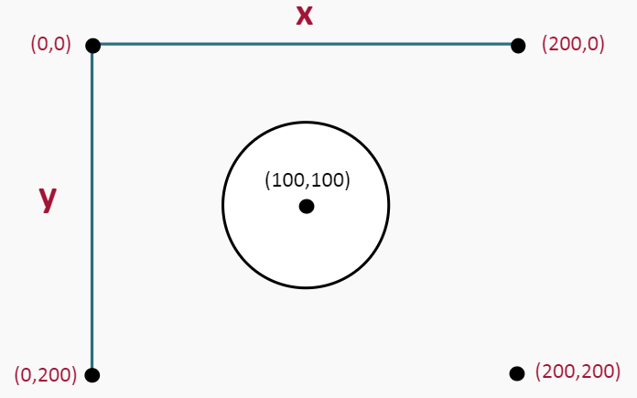
Drawing an Ellipse
On a stage that is 200px by 200px, the ellipse looks like this:

Slide 18
Drawing an Ellipse Practice
Fill in the blanks in the code snippet below to create an ellipse at point (100, 200) that is 200px wide and 100px high.

Slide 19
Drawing an Ellipse Practice
Fill in the blanks in the code snippet below to create an ellipse that is 100px wide by 100px high in the centre of the display window.
Answer

Slide 20
Drawing an Ellipse Practice
Fill in the blanks in the code snippet below to create an ellipse at point (0,0) that is 150px wide by 150px high in a window that is 600px by 600px.

Slide 21
Try It Yourself
In a window that is 600px by 400px, draw an ellipse at the point (300, 200) that is 100px wide by 100px high.
Set the size of the window to 600px by 400px.
Draw an ellipse that is 100px by 100px at point (300, 200)

Slide 22
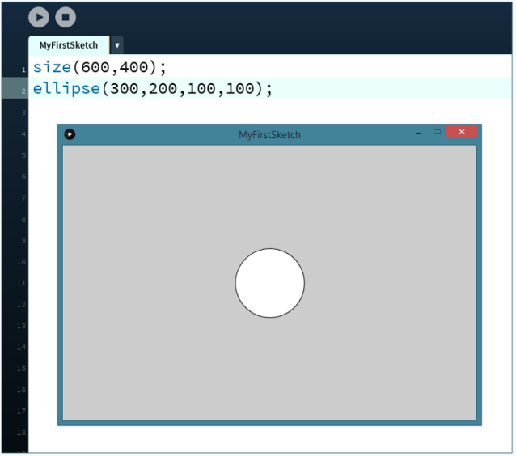
Try It Yourself Solution

Slide 23
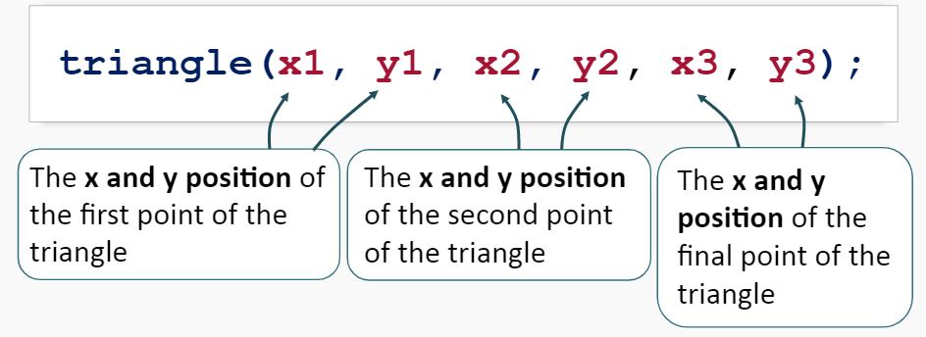
Drawing a Triangle
We can use the built in triangle function to draw a triangle.
The triangle() function needs six arguments:

Slide 24
Drawing a Triangle
For example, the code:
Will draw a line from point (10,100) to point (100,10) and then to point(190,100) creating a triangle.
Try it yourself in Processing.

Slide 25
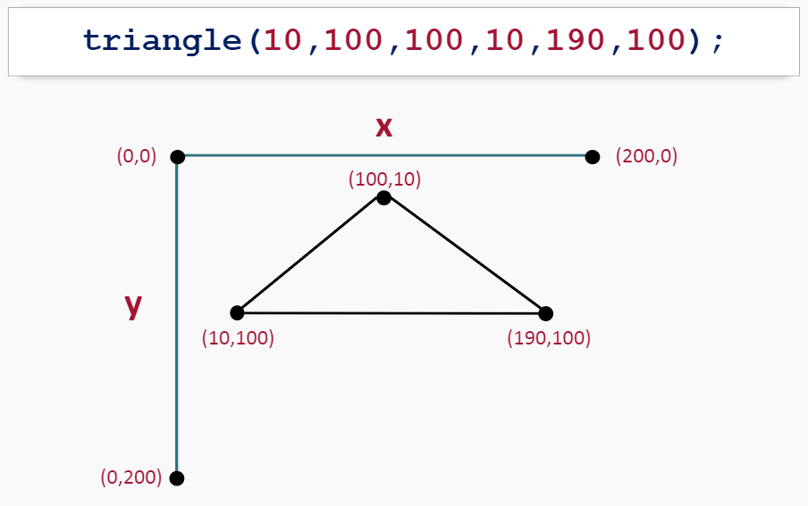
Drawing a Triangle

Slide 26
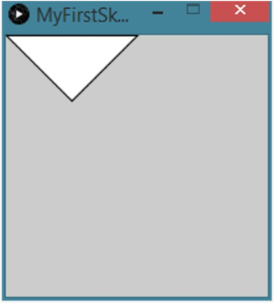
Try It Yourself
Draw a triangle with points at: (0,0) , (100,0) and (50,50).

Slide 27
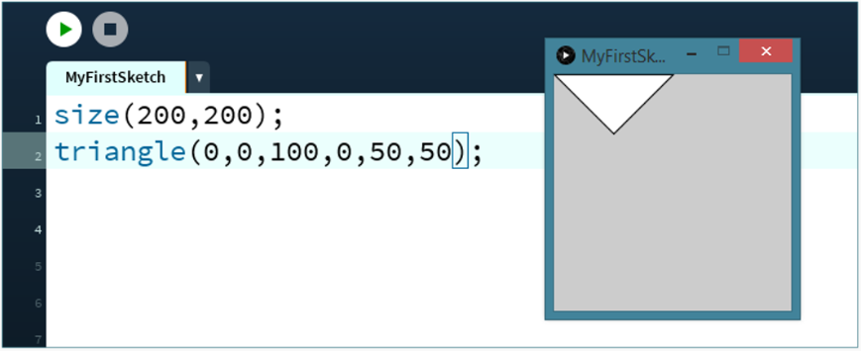
Try It Yourself Solution

Slide 28
Drawing a Rectangle
We can use the built in rect() function to draw a rectangle.
The rect() function needs four arguments:

Slide 29
Drawing a Rectangle
For example, the code:
Will draw a rectangle that has a top left point at (10,10) and has a width of 150px and a height of 100px.
Try it yourself in Processing.

Slide 30
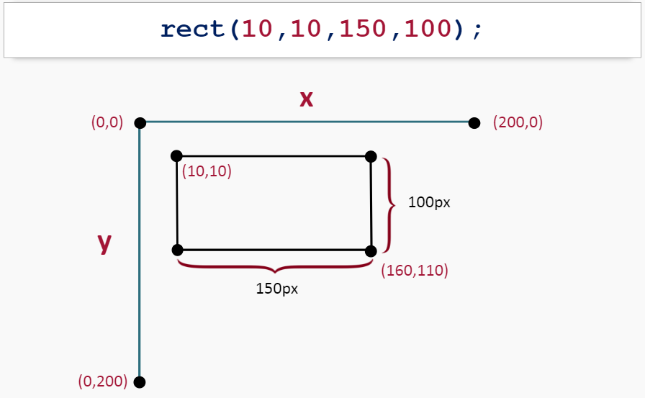
Drawing a Rectangle

Slide 31
Drawing Rectangles Practice
Fill in the blanks in the code snippet below to draw a rectangle that has a corner at (100,100) and is 300px wide and 200px tall.

Slide 32
Drawing Rectangles Practice
Fill in the blanks in the code snippet below to draw a rectangle that has a corner at (0,0) and is 500px wide and 600px tall.

Slide 33
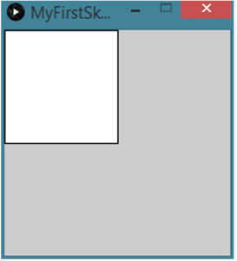
Try It Yourself
Draw a rectangle with the top left corner at (0,0) with a width of 100px and a height of 100px.

Slide 34
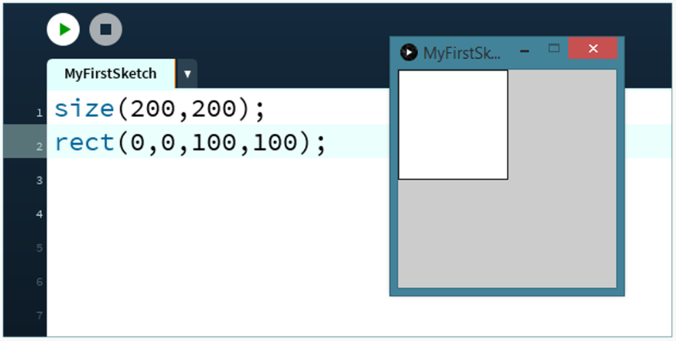
Try It Yourself Solution

Slide 35
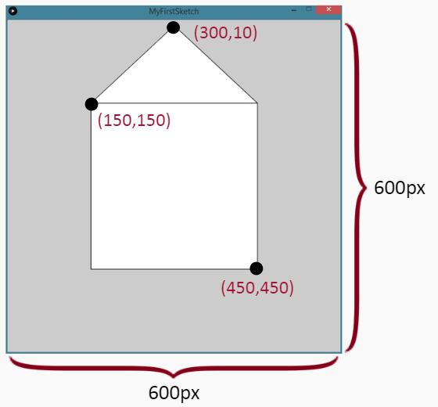
Try It Yourself Challenge
Challenge! Use the built in drawing functions to draw:

Slide 36
Summary
Change the size of the display window:
Draw an ellipse:
Draw a line from point (x1, y1) to (x2, y2):

Slide 37
Summary
Draw a triangle from (x1, y1) to (x2, y2) to (x3, y3):
Draw a rectangle with the top left point (x, y):

