Slide 1
Order of Operations/BEDMAS

Slide 2
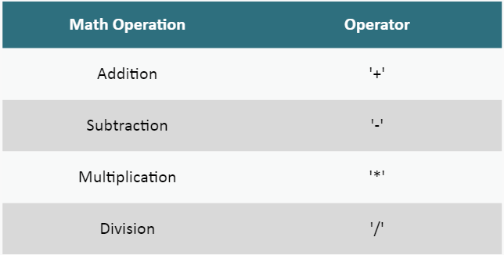
Basic Math Operators
Math operators are the characters used to instruct Processing you want to perform calculations:

Slide 3
Basic Math Operators
Math operations are typically used on the right hand side of the assignment operator (=), which assigns the result of a calculation to a variable.
Math operations can also be used as values in other statements.

Slide 4
Order of Operations/BEDMAS
When Processing performs arithmetic operations, it follows a strict set of guidelines of what to do and in what order. This is the default order:
Multiplication/Division
Left to right in the order encountered
Addition/Subtraction
Left to right in the order encountered
Assignment
Places the value into the variable

Slide 5
Order of Operations/BEDMAS Example
computedValue = 15 – 4 * 2 – 1;
The 4*2 multiplication is done first, yielding an answer of 8
Next is 15-8 (result of the multiplication), yielding an answer of 7
Last is 7 (from subtraction above) – 1, yielding a final answer of 6
Now place the final answer 6 into variable computedValue

Slide 6
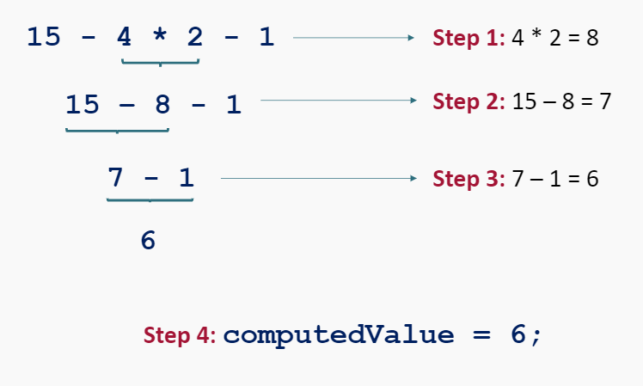
Order of Operations/BEDMAS Example

Slide 7
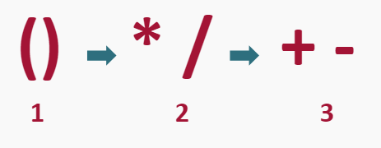
Altering the Order
The default order of operations can be changed using parentheses ‘(‘ and ‘)’
When parentheses are used, it instructs Processing to ‘do anything in parentheses first’.

Slide 8
Altering the Order Example
computedValue = 15 – 4 * (2 – 1);
Complete parentheses first (2-1) = 1
Complete multiplication next 4 * 1 (result of calculation in parentheses) = 4
Complete final subtraction of 15 – 4 (result of multiplication), yielding a final answer of 11
Assign the final answer into variable computedValue

Slide 9
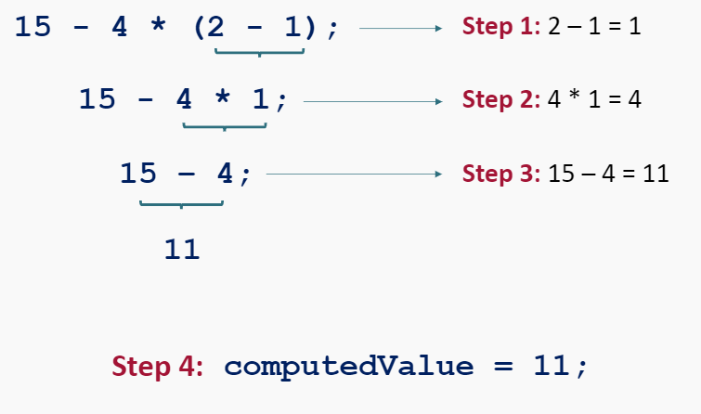
Altering the Order Example

Slide 10
Order of Operations/BEDMAS
Order of operations/BEDMAS applied to the contents of parentheses
For example, if you have this formula:
2 * (3 + 6 * 7)
The 6 * 7 would be done first
The 3 would be added within the parentheses
Finally, the result is multiplied by 2.
The actual answer would be 90.

Slide 11
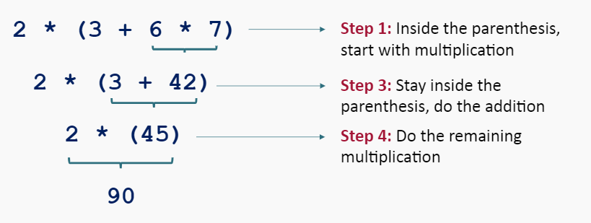
Order of Operations/BEDMAS Example

Slide 12
Order of Operations/BEDMAS Practice
What is the result of:
Type your response into the box below:

Slide 13
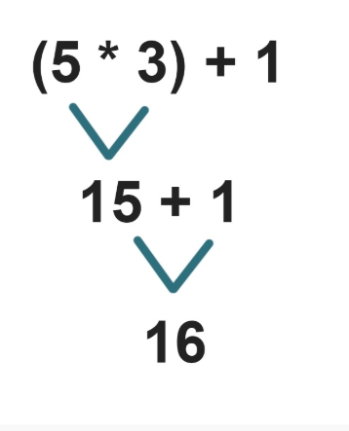
Order of Operations/BEDMAS Practice

Slide 14
Order of Operations/BEDMAS Practice
What is the result of:
Type your response into the box below:

Slide 15
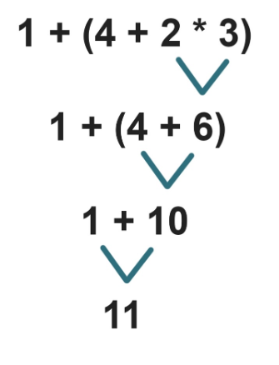
Order of Operations/BEDMAS Practice

Slide 16
Order of Operations/BEDMAS Practice
What is the result of:
Type your response into the box below:

Slide 17
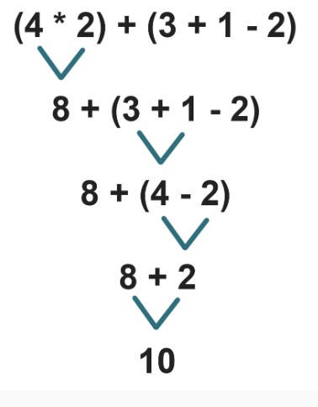
Order of Operations/BEDMAS Practice

Slide 18
Summary
When Processing performs arithmetic operations, it follows a strict set of guidelines of what to do and in what order. These are called Order of Operations/BEDMAS:
Parenthesis
Any operations in Parenthesis are done first
Multiplication/Division
Left to right in the order encountered
Addition/Subtraction
Left to right in the order encountered
Assignment
Places the value into the variable

