Slide 1
Consumer Decisions
Unit 3

Slide 2
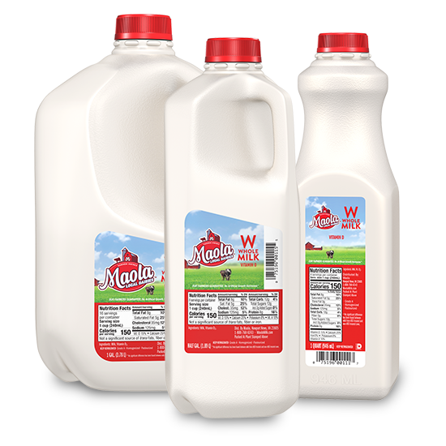
3.2 Unit Price
Products are packaged and sold in various sizes, such as 1 L, 2L or 4L jug of milk.
How can you determine the least expensive choice?

Slide 3
3.2 Unit Price
Finding the unit price will allow you to compare and help you determine the best value.
Unit Price: the price per item, per unit of weight or per unit of volume , sometimes referred as unit cost.

Slide 4
3.2 Unit Price
Most of the time you spend less per unit when you buy the larger size. However, sometimes the smaller size costs less per unit, especially if there is a sale.

Slide 5
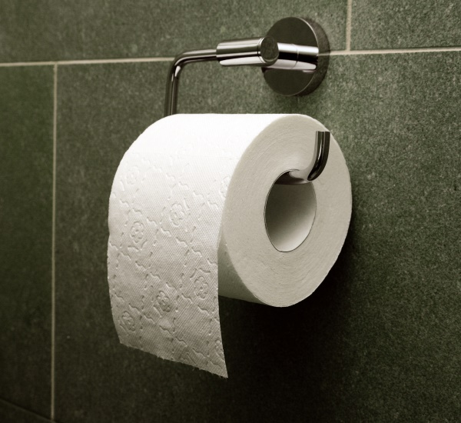
3.2 Unit Price
Example 1:
If you buy a package of 4 rolls of toilet paper for $2.68, calculate the cost per roll.
2.68 / 4 = .67
67 cents per roll

Slide 6
3.2 Unit Price
Example 2:
Find the price for each of the products listed
Item | Weight | Price | Price
Apples | .5kg | .99 | 1.98 / kg
Perfume | 50 ml | $25 | $2 / ml
Cola | 2 L | 1.69 | .85 / L

Slide 7
3.2 Unit Price
Example 3: Jellybeans can be bought for the following prices:
84 cents for 300g
$1.20 for 500g
$3.25 for 1.25 kg (1000 g / kg)
Which of these has the lowest unit price?

Slide 8
3.2 Unit Price
A) 84 cents / 300 g = .28 cents per gram
B) 120 cents/ 500g = .24 cents per gram
C) 325 cents / 1250 g = .26 cents per gram
B has the lowest unit cost

Slide 9
3.2 Unit Price
Do exercise 3.2

Slide 10
3.3 Using Coupons
One way to save money shopping for groceries is to use manufacturer coupons. These are special vouchers made by companies that manufacture, process and package foods.
The consumer can usually save a few cents for the food item mentioned on the coupon.

Slide 11
3.3 Using Coupons
Extreme Couponing

Slide 12
Using Coupons
Example 1:
Molly has a coupon for 85¢ off each box of Frosted Flakes. If one box costs $3.99, how much will it cost if Molly decides to buy 3 boxes?
Price for one box 3.99 - .85 = $3.14
Price for 3 boxes 3 x 3.14 = $9.42

Slide 13
Using Coupons
Example 2:
Superstore sells a 2.84 L jug of Tropicana Orange Juice for $5.99. Janet has a coupon for $2.50 off when you buy 2 jugs of Tropicana Orange Juice. Calculate the cost of the OJ if Janet decided to use the coupon.
Cost for 2 jugs 2 x 5.99 = $11.98
Subtract the coupon $11.98 – 2.50 = $9.48

Slide 14
Using Coupons
Listed are some coupons that appear in the local paper. These coupons are redeemed at face value at Kidd’s Korner Store, double the value at Lobbela’s. No coupons redeemable at H & R because of everyday low prices. With this in mind, calculate the cost of the grocery list at each store.
Where would you shop?

Slide 15
Using Coupons
Kidd’s Korner Store
Item | Coupon | Total Price
1 can of ham | .25 | 8.39 - .25 = $8.14
2 lbs butter |  | 2 x 3.49 = $6.98
4 L ice cream | .15 | 3.69 - .15 = $3.54
6 boxes apple juice | .10 | 6(1.39 - .10) = $7.74
6 boxes pizza pops | .50 | 2(3.59- .50) + 4(3.59) = $20.54
1 tube toothpaste |  | .79
TOTAL |  | $47.73

Slide 16
Using Coupons
Lobbela’s
Item | Coupon | Total Price
1 can of ham | .25 | 7.79 - .25 = $7.54
2 lbs butter |  | 2 x 3.19 = $6.38
4 L ice cream | .15 | 5.49 - .15 = $5.34
6 boxes apple juice | .10 | 6(1.59 - .10) = $8.94
6 boxes pizza pops | .50 | 2(3.79-.50) + 4(3.79) = $21.74
1 tube toothpaste |  | .88
TOTAL |  | $50.82

Slide 17
Using Coupons
H & R
Item | Coupon | Total Price
1 can of ham |  | 6.99
2 lbs butter |  | 2 x 3.09 = 6.18
4 L ice cream |  | 3.49
6 boxes apple juice |  | 6 x 1.28 = $7.68
6 boxes pizza pops |  | 6 x 3.69 =$ 22.14
1 tube toothpaste |  | 2.39
TOTAL |  | $48.87

Slide 18
Using Coupons
Compare Total costs
Kidd’s Korner Store: $47.73
Lobbela’s: $50.82
H & R $48.87
We should shop at Kidd’s Korner Store

Slide 19
Using Coupons
Do exercise 3.3

Slide 20
Taxes
When buying items in a store you need to pay taxes.
In Canada, we have Provincial Sales Tax (PST) and federal Goods and Services Tax (GST)
The percent rate of PST differs from province to province and each province applies sales tax to different commodities.
The GST is the same throughout Canada

Slide 21
Taxes
Some provinces (Quebec) have a Harmonized Sales Tax which both PST and GST are combined to make one tax.
In Manitoba, we have PST of 7% and GST of 5%
When you buy goods, you need to think not only of the price but also how much more an item will cost with taxes

Slide 22
Taxes
Review: Calculating Percents
A percent means.. Out of 100
40% means 40 / 100
75% means 75 / 100

Slide 23
Taxes
Example 1:
How much tax will Miranda pay when she buys a blouse prices at $49.95 in Manitoba. How much will she pay altogether for the blouse?
PST = 49.95 x .07 = $3.50
GST = 49.95 x .05 = $2.50
Total tax: $6.00
Total Purchase: $49.95 + 6.00 = $55.95

Slide 24
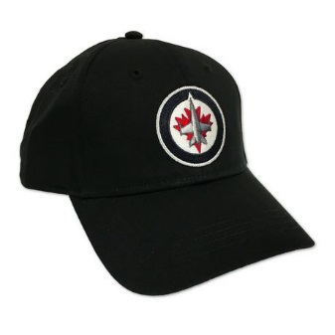
Taxes
How much will Travis pay when he buys a Jet’s hat at $32.99 in Manitoba?
32.99 x .07 = 2.31
32.99 x .05 = 1.65
32.99 + 2.31 + 1.65 =
$36.95

Slide 25
Taxes
Goods and Services Exempt from GST
House sales
Long term rentals
Most medical expenses
Child care services
Legal aid fees
Educational services
Music lessons
Some financial services
Notes:
https://www.canada.ca/en/revenue-agency/services/forms-publications/publications/rc4022/general-information-gst-hst-registrants.html#H1_106

Slide 26
Taxes
Do exercise 3.4

